Slide 1
Multimedia
Outline
  Compression
  RTP
  Scheduling

Slide 2
Compression Overview
Encoding and Compression
  Huffman codes
Lossless
  data received = data sent
  used for executables, text files, numeric data
Lossy
  data received does not != data sent
  used for images, video, audio

Slide 3
Lossless Algorithms
Run Length Encoding (RLE)
  example: AAABBCDDDD encoding as 3A2B1C4D
  good for scanned text (8-to-1 compression ratio)
  can increase size for data with variation (e.g., some images)
Differential Pulse Code Modulation (DPCM)
  example AAABBCDDDD encoding as A0001123333
  change reference symbol if delta becomes too large
  works better than RLE for many digital images (1.5-to-1)

Slide 4
Dictionary-Based Methods
Build dictionary of common terms
  variable length strings
Transmit index into dictionary for each term
Lempel-Ziv (LZ) is the best-known example
Commonly achieve 2-to-1 ration on text
Variation of LZ used to compress GIF images
  first reduce 24-bit color to 8-bit color
  treat common sequence of pixels as terms in dictionary
  not uncommon to achieve 10-to-1 compression (x3)

Slide 5
Image Compression
JPEG: Joint Photographic Expert Group (ISO/ITU)
Lossy still-image compression
Three phase process
  process in 8x8 block chunks (macroblock)
  greyscale: each pixel is three values (YUV)
  DCT: transforms signal from spatial domain into and equivalent signal in the frequency domain (loss-less)
  apply a quantization to the results (lossy)
  RLE-like encoding (loss-less)
JPEG compression
Source
Compressed
image
DCT
Quantization
Encoding
image

Slide 6
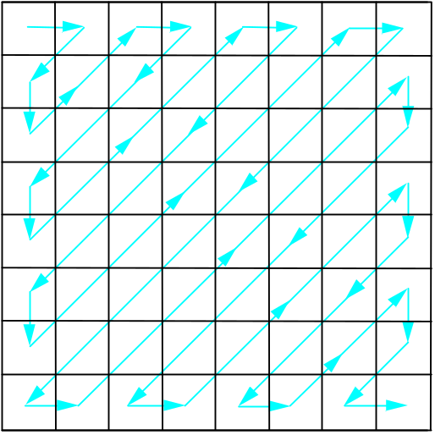
Quantization and Encoding
Quantization Table
3 5 7 9 11 13 15 17
5 7 9 11 13 15 17 19
7 9 11 13 15 17 19 21
9 11 13 15 17 19 21 23
11 13 15 17 19 21 23 25
13 15 17 19 21 23 25 27
15 17 19 21 23 25 27 29
17 19 21 23 25 27 29 31
Encoding Pattern

Slide 7
MPEG
Motion Picture Expert Group
Lossy compression of video
First approximation: JPEG on each frame
Also remove inter-frame redundancy

Slide 8
MPEG (cont)
Frame types
  I frames: intrapicture
  P frames: predicted picture
  B frames: bidirectional predicted picture
Example sequence transmitted as I P B B I B B
Input
Frame 1
Frame 2
Frame 3
Frame 4
Frame 5
Frame 6
Frame 7
stream
MPEG
compression
Forward
prediction
Compressed
I frame
B frame
B frame
P frame
B frame
B frame
I frame
stream
Bidirectional
prediction

Slide 9
MPEG (cont)
B and P frames
  coordinate for the macroblock in the frame
  motion vector relative to previous reference frame (B, P)
  motion vector relative to subsequent reference frame (B)
  delta for each pixel in the macro block
Effectiveness
  typically 90-to-1
  as high as 150-to-1
  30-to-1 for I frames
  P and B frames get another 3 to 5x

Slide 10
RTP
Application-Level Framing
Data Packets
  sequence number
  timestamp (app defines “tick”)
Control Packets (send periodically)
  loss rate (fraction of packets received since last report)
  measured jitter

Slide 11
Real-Time Scheduling
Priority
Earliest Deadline First (EDF)
Rate Monotonic (RM)
Proportional Share
  with feedback
  with adjustments for deadlines

